Slide 1
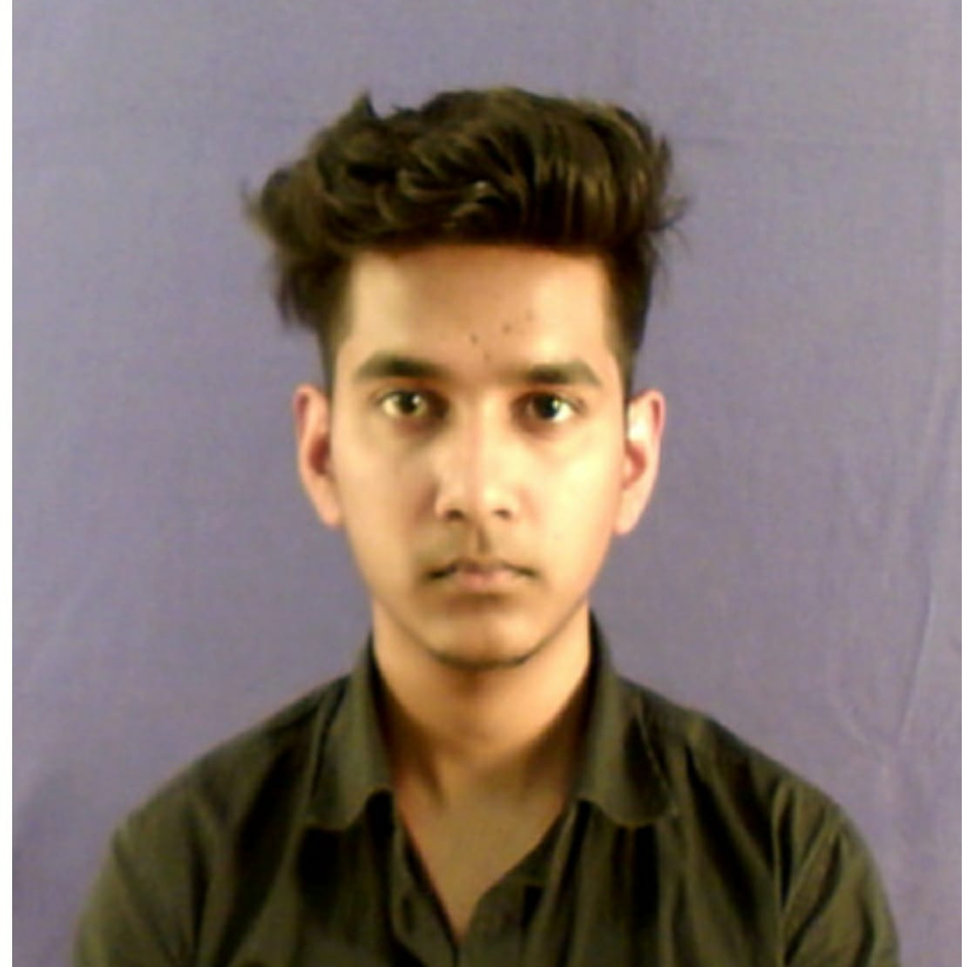

SOURAV KUMAR HIANL
Analyst/Software Engineer
Bachelor of Technology
Computer science & Eng. :2017-2021
Skills
Mumbai
JAVA | JAVA Basics, OOPS, Generics, Collections, Arrays, Loops, Data Types in JAVA;
SPRING | Spring microservices, Entity Framework Spring MVC Spring security
J-UNIT | Mockito and Junit Testing
UI Framework-React | Fundamentals components ,Java Script, Working with states & props in React , Event Handling in React , Routing ,Life Cycle Method, Working with HTTP in React.
React | Components, Services, Modules, Routing, Forms & Validation, Testing using Jasmin & Karma
Database | MongoDB
UI Tech | HTML 5 & CSS 3,JavaScript, Optimized UI Designed
Tools | Visual Studio 2019, Visual Studio code, Swagger, Postman, SSMS, Intellij.
Add On skills | Communications, Team management. Peer learning
Sourav.kumar-hianl@capgemini.com
+91 8342983859
A4
Proficient in JAVA and OOPs concepts.
Hands on experience in creating Web Application with Spring boot , Java, Rest API, React.
Hands on experience in developing web pages using HTML5, CSS3, Object Oriented Programming, JSON, XML. Good understanding of Document Object Model (DOM) and DOM Functions.
Proficient React developer with working knowledge on React.
Implemented Rest API and React in case study and up skilling this knowledge continuously.
On Demand Car Wash System
Working on end to end case study of On demand car wash Application along with authentication, Swagger and React used for user interface.
JavaScript and React for web developers in Degreed Platform
Completed this course with optimal Knowledge of MVC ,Web API , RESTful services , Components.

